Slide 1
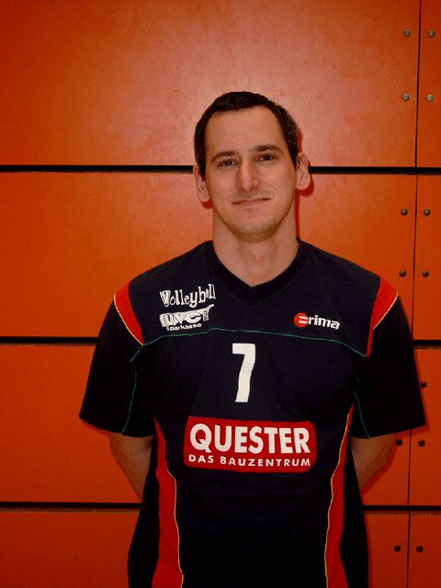
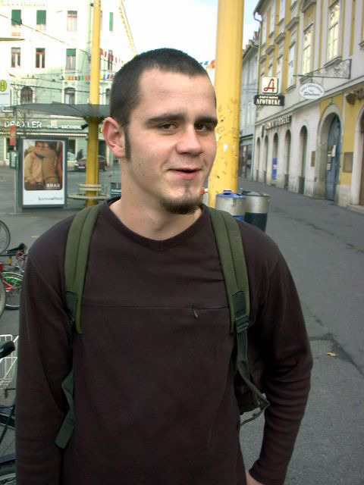
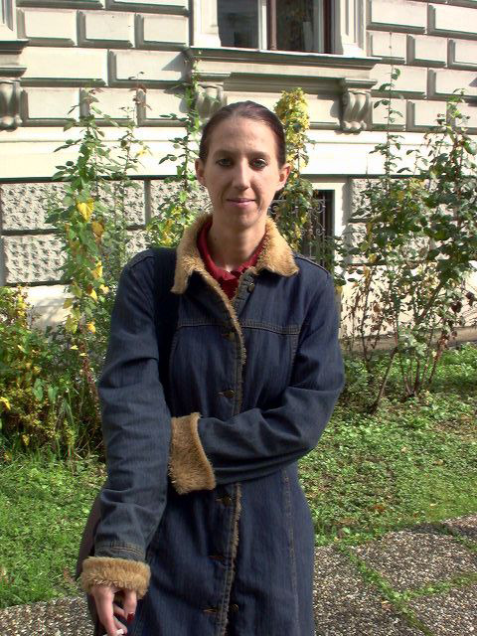
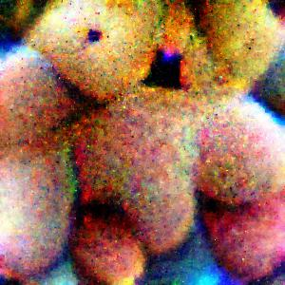
Overview-Fooling automated surveillance cameras**
In this work,
We will try to train a patch on people dataset, so that a typical object detection model do not recognize it as a people.
We will use a dataset consisting of simple images of Human (mostly of pedestrian)
We will start with an image as patch.
Then use FSGM approach to train the patch to make the model not detect the Human in the image
End goal of this work is to generate awareness in cyber sec area that a simple OD for human can be bypassed with a little prints on bags/t-shirts etc.
Images, Patch →

Slide 2
Solution Design
ML Type – Supervised ML (Classification, Object detection)
Metrics – Accuracy
Data(Train) – 50 Images
Data(Test) – 10 Images
Data preparation → Model training → Validation
Get BBox of all Images
Add raw patch in all
Check score on Test data with a Random patch
Repeat with trained patch
Get the Gradient of Loss w.r.t the images
Update only the patch portion of the images to reduce Loss

Slide 3
Data Preparation
+
→
Object detection
Model
Loss Fn.
Update patch

Slide 4
Model
Image
OD Model
Get BBox
Add patch inside the BBox
Save the values of patch area
Patched Image
OD Model
Get Loss
Calculate Gradient
Update patch area of the image to reduce Loss
OD Model parms. are frozen
Loss is CrossEntropy Loss
OD model is a pre-trained model trained on COCO 2017 Dataset

Slide 5
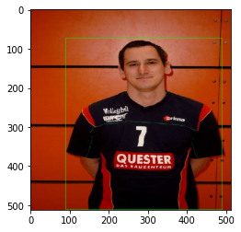
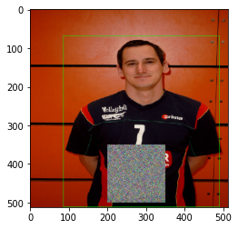
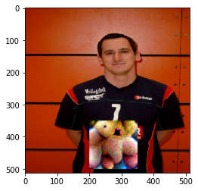
Performance
Train Acc - 96% Test Acc - 90%

